Slide 1

Welcome to our Thesis
A Hybrid Model: Software Risk Identification and Software risk Analysis in Bangladesh IT Industry

Slide 2
SUPERVISED BY
ABHIJIT BHOWMIK
Associate Professor, Department of Computer Science
American International University-Bangladesh

Slide 3
GROUP MEMBERS
TANIA RAHMAN [17-33841-1]
SHANTO KUMAR SAHA [17-34699-2]
MD. TAMIM MAULA [16-32586-2]
MD. SAJJADUR RAHMAN SOHEL [17-34017-1]

Slide 4
OUTLINE
INTRODUCTION
LITERATURE REVIEW
RESEARCH METHODOLOGY
RESULTS AND ANALYSIS
CONCLUSION AND FUTURE WORK
REFERENCES

Slide 5
INTRODUCTION

Slide 6
RESEARCH MOTIVATION
Very few studies focus on Bangladeshi IT industries.
Increasing software products, risk factors and the risk impact areas rising simultaneously (In Bangladesh).
Mitigating risk impact areas.
Propose easy and readable paper.

Slide 7
CORE BACKGROUND STUDY
Studied BOEHM Software Risk Management: Principles and Practices
Studied on previous research paper, article, journal, book title etc.

Slide 8
RESEARCH OBJECTIVE
Objective:
Research question:
Main Objective: Software Risk Identification and Software risk Analysis in Bangladesh IT Industry.
Sub-objective 1: To investigate what types of software risks Bangladesh IT industry are facing to manage a software project.
Sub-objective 2: To investigate the reasons for software risk areas in Bangladesh IT Industry.
Sub-objective 3: To analyze the software risk in Bangladesh IT Industry.
Main research question: Does the Bangladesh IT Industry able to mitigate the risk impact areas for developing software projects.
Sub-question 1: Does the paper investigate the types of software risks of Bangladesh IT industry that they are facing to manage a software project.
Sub-question 2: Does the paper investigate the reasons for software risk areas in Bangladesh IT Industry.
Sub-question 3: Does the paper analyze the software risk in Bangladesh IT Industry.

Slide 9
LITERATURE REVIEW

Slide 10
RELATED WORK
Used the “Synthesized formula” for mitigating risks (Ahdieh Sadat Khatavakhotan and Siew Hock Ow) [1].
Same authos proposed another model [10] that focused on DVC (Dynamic Verifier Core).
Again in [2] improving the previous model with four phases.

Slide 11
RESEARCH METHODOLOGY

Slide 12
PROBLEM FINDING
Classify risk impact areas:
Identify Risk Impact Areas:
Different types of risk areas:
User communication and functional requirements
Lack of strong performance
Tight Schedules
Budget Switching
Technical Difficulties
Improper use of new technologies
Poor Management
Application and framework engineering
Programmatic
Operational
Tight schedules (60.7%)
Budget changes (65.9%)
Technical Difficulties (46.8%)
Poor management (37%)
Unproven Technologies (63.6 %)
User Communication and Functional Requirements (68.2%)
Application and System Architecture (43.4%)
Performance issue (28.9 %).

Slide 13
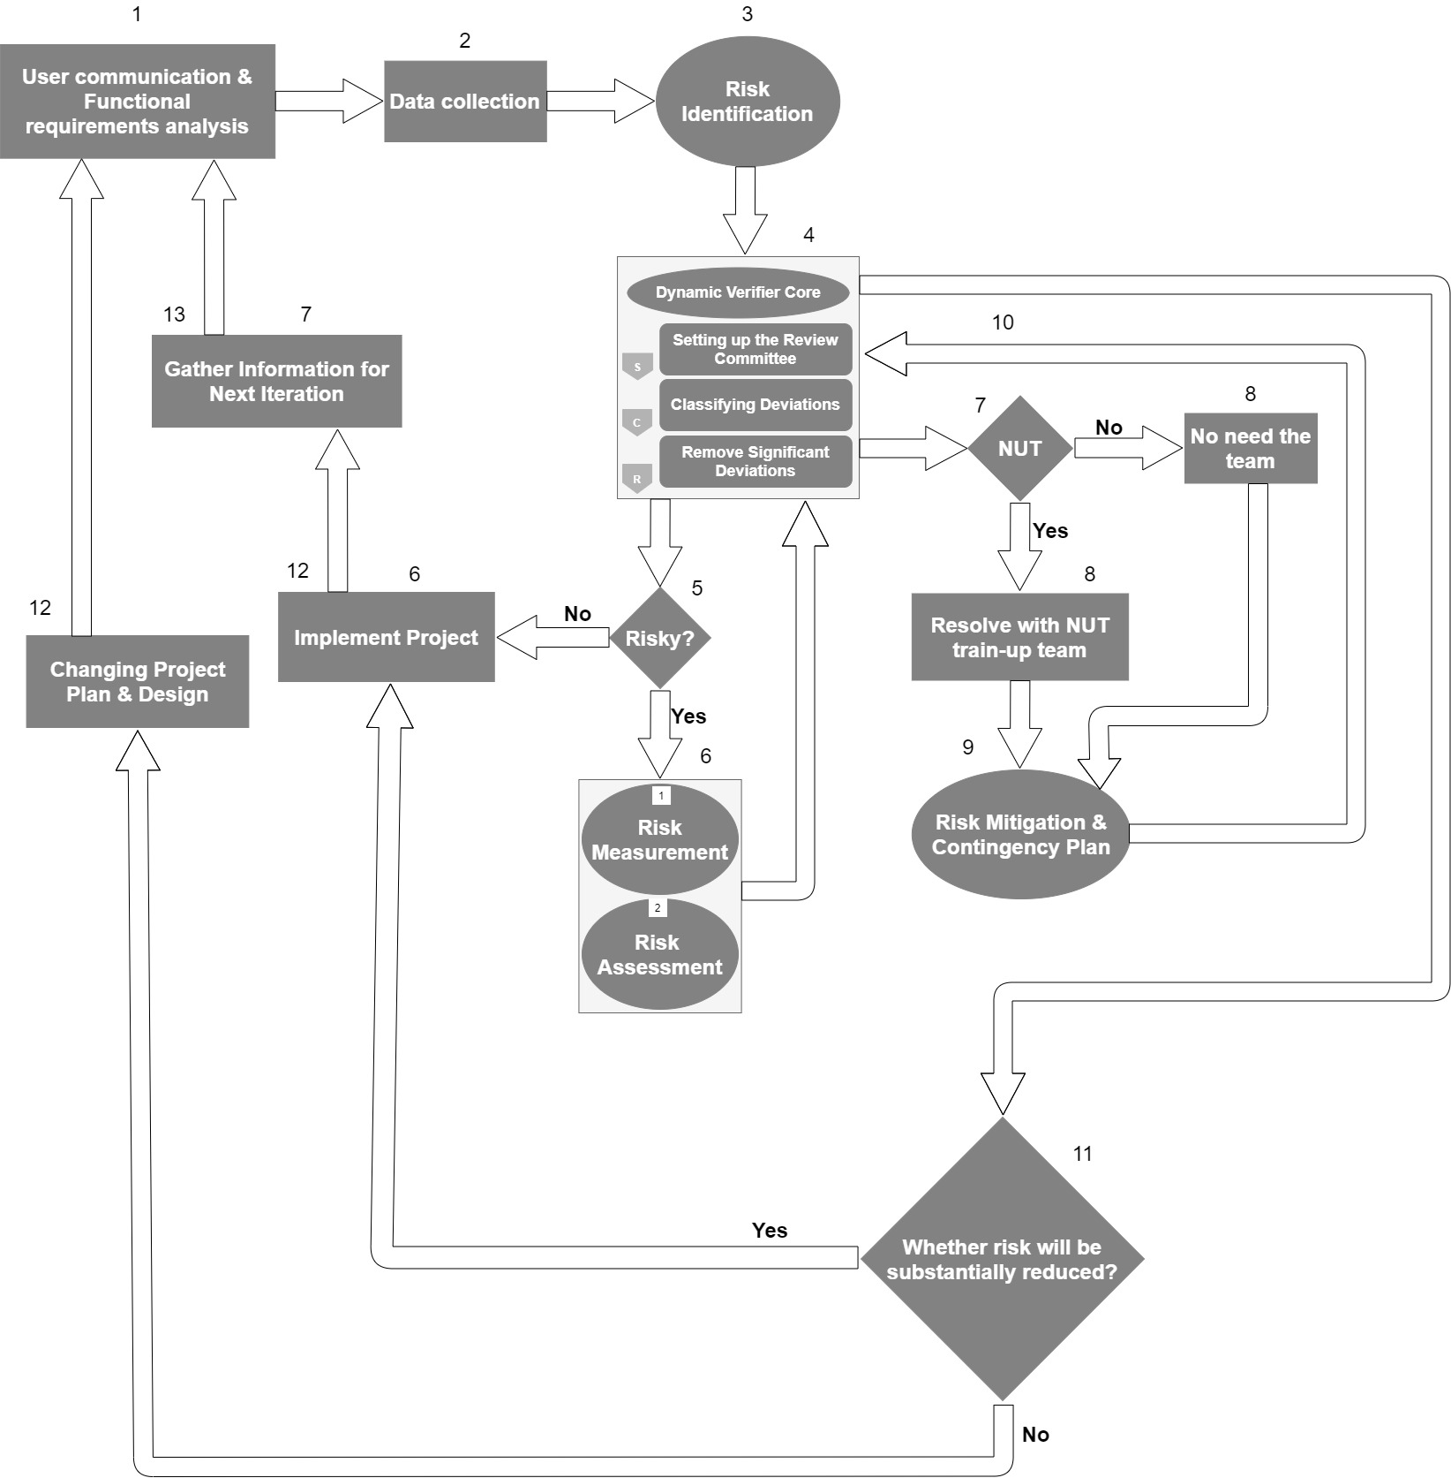
PROPOSED MODEL FOR MITIGATING RISKS
Figure 3.3: Hybrid Model for Mitigating Risks

Slide 14
FOUR PHASES OF PROPOSED MODEL
Phase 1: Risk Identification
Phase 2: Risk Measurement
Phase 3: Risk Assessment
Phase 4: Risk Mitigation and Contingency Plan

Slide 15
PHASE 1: RISK IDENTIFICATION
Documentation Reviews
Brainstorming and interviewing
SWOT Analysis (STRENGTH, Weakness, Opportunities, and Threats)
Developing and analyzing agendas of dangers
Analysis of Root Cause
Creating the circumstances and logical results chart

Slide 16
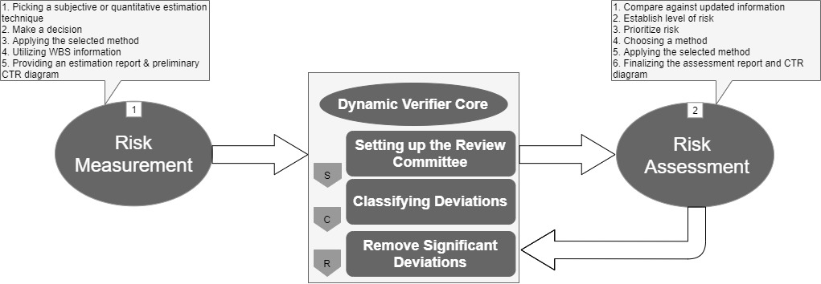
PHASE 2: RISK MEASUREMENT & PHASE 3: RISK ASSESSMENT
Figure 3.3.2: Risk Measurement and Risk Assessment

Slide 17
PHASE 2 & PHASE 3
Phase 2: risk measurement:
Phase 3: risk assessment:
Picking a subjective or quantitative estimation technique
Make a decision
Applying the selected method
Utilizing WBS information
Providing an Estimation Report & Preliminary CTR (Cost Time Risk) Diagram
Compare against updated information
Establish level of risk
Prioritize risk
Choosing a method
Applying the selected method
Finalizing the assessment report and CTR diagram

Slide 18
PHASE 4: RISK MITIGATION AND CONTINGENCY PLAN
Identifying the hazardous risk
Characterizing plausible decision for risk mitigation
Deciding the activity for every decision
Diminishing the occurrence probability and results of risks
Applying the utilization of mathematical formulas
Driving the actual risks
Designing Contingency Plan

Slide 19
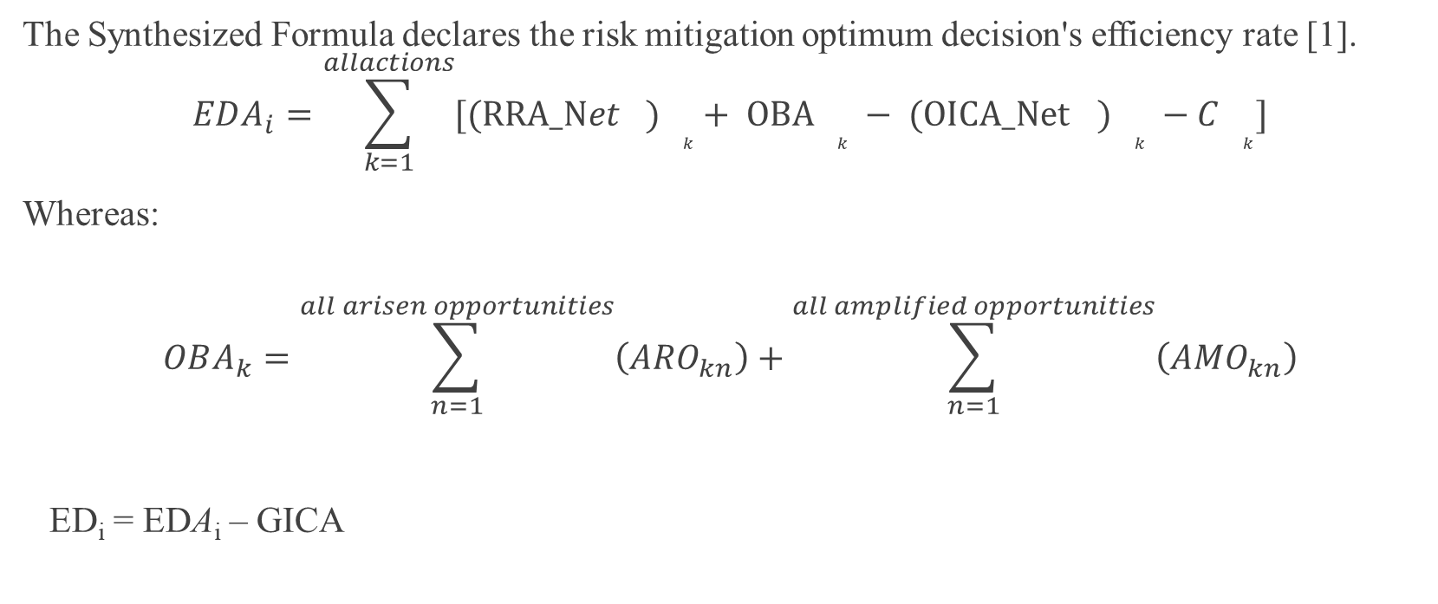
SYNTHESIZED FORMULA
The Synthesized Formula declares the risk mitigation optimum decision's efficiency rate [1].
$$EDA_{i}=\sum_{k=1}^{allactions}{[({RRA_Net}_{}){}_{k}+ OBA{}_{k} − ({OICA_Net}_{}){}_{k} −C{}_{k}]}$$
Whereas:
$$OBA_{k}=\sum_{n=1}^{all arisen opportunities}{\left(ARO_{kn}\right)}+\sum_{n=1}^{all amplified opportunities}{\left(AMO_{kn}\right)}$$
ED_{i} = EDA_{i} – GICA

Slide 20
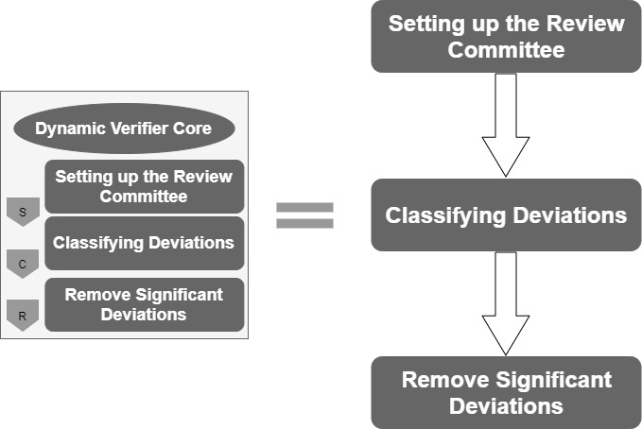
DYNAMIC VERIFIER CORE (DVC)
Figure 3.3.3: DVC (Dynamic Verifier Core)

Slide 21
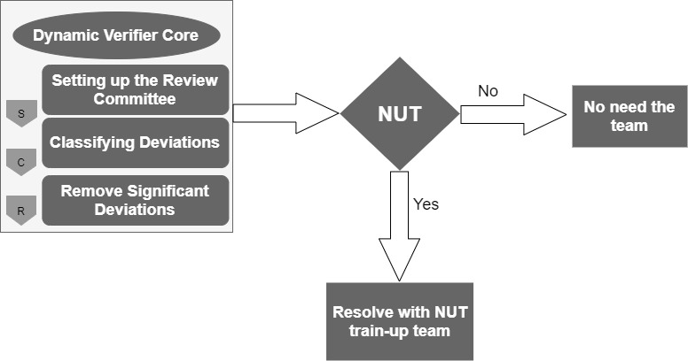
UNIQUE FEATURE OF THE PROPOSED MODEL
Figure 3.3.4: NUT train-up team

Slide 22
UNIQUE FEATURE OF THE PROPOSED MODEL
Make train-up team on new-unproven-technology
Have to keep proper information/knowledge (previous & present records)
Identify the type of technology
Compare with previous & present risk records
Resolve the technical problem
Pass the updated solution to DVC

Slide 23
RESULTS AND ANALYSIS

Slide 24
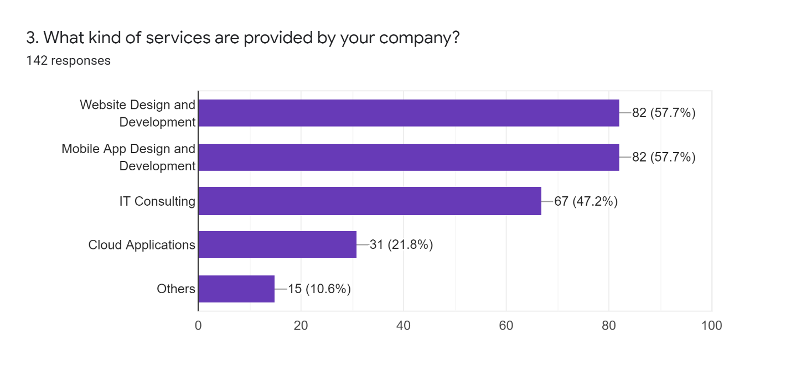
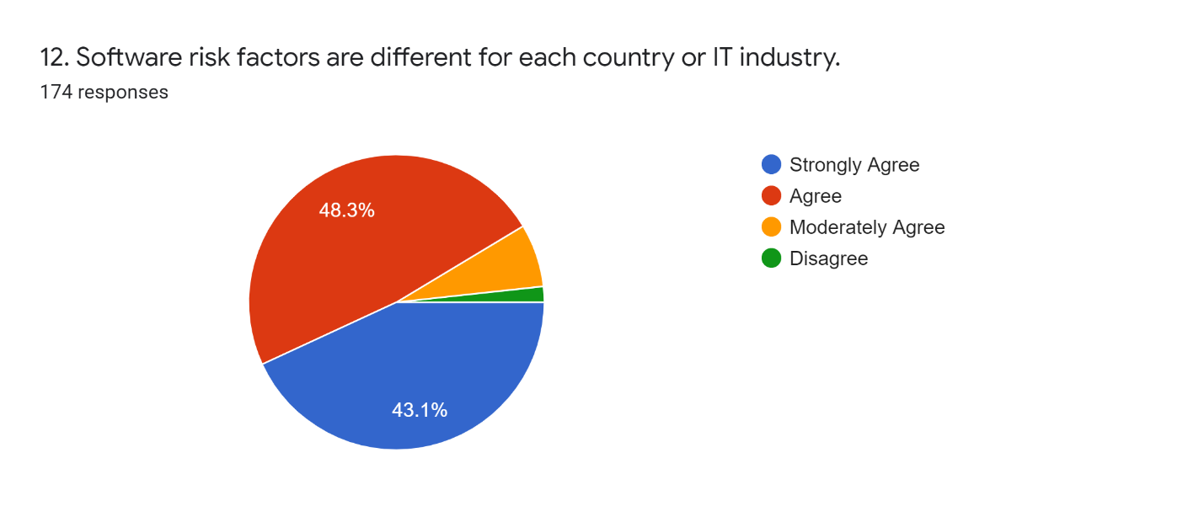
SURVEY RESULTS

Slide 25
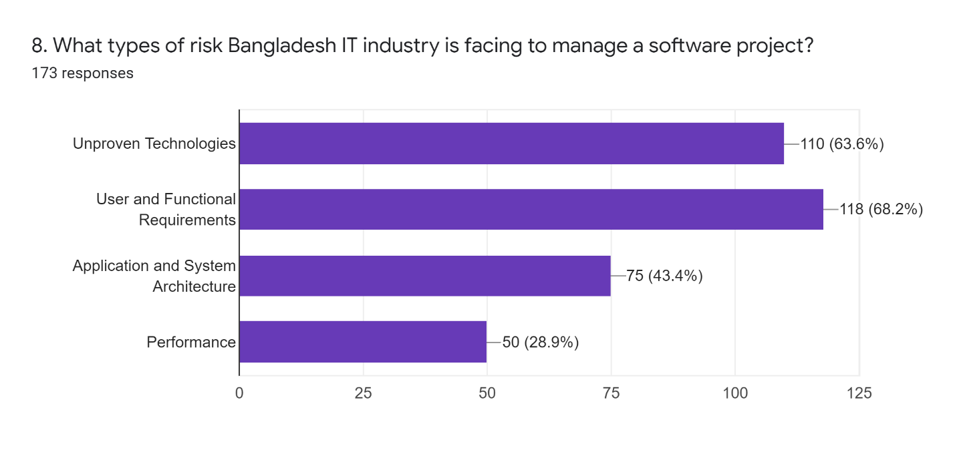
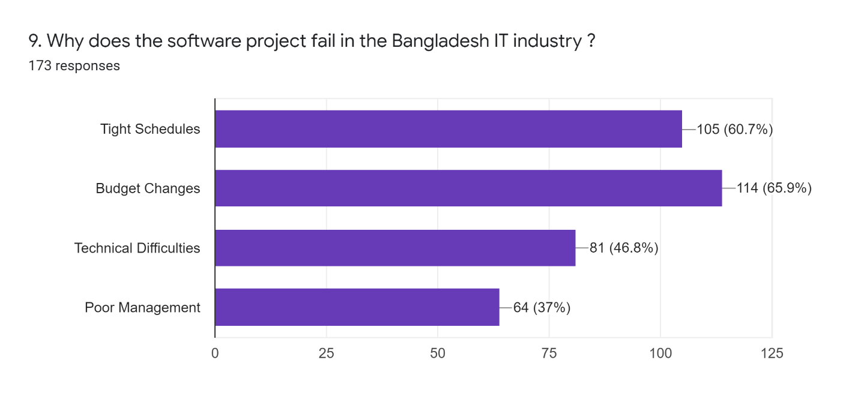
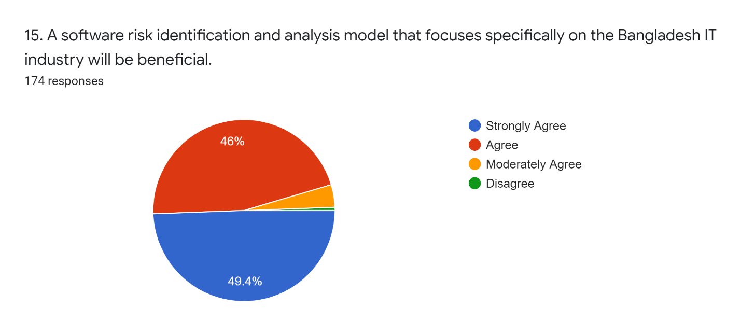
SURVEY RESULTS

Slide 26
RESULT ANALYSIS
Found some factors that are coming multiple times and related directly or indirectly to other factors.
New Unproven Technologies, User and Functional Requirements, Tight Schedules, and Budget Changes are most irritating risks.

Slide 27
SUGGESTION OF REDUCING RISK FOR SOME RISK IMPACT AREAS
Tight Scheduling
Clear your plan for getting work done
Get help all along
Break the project down
Work on it slowly and carefully
Have a disclaimer in proposition and statements
Budget Changing
double check (team know about the specific necessities)
converse with team about change control interaction
rundown of necessities continues to climb

Slide 28
SOLUTION VERIFICATION
Found out most critical risk impact areas [New, Unproven Technologies, User Communication and Functional Requirements, Tight schedules, Budget changes]
Proper user communication and functional requirements analysis
DVC verify the four phases (risk substantially reduce)
NUT train-up team resolve new technological issues
Synthesized Formula declares the risk mitigation optimum decision's efficiency rate

Slide 29
ADVANTAGES OF PROPOSED MODEL
Simply follow a simple path (it has simplicity)
Transparency for new technology
No chance for decision mismatch (Each phase verify by same people)
Concern about user communication and functional requirements
Transparency of each phase and the gradual occurrence of the risk impact areas
Covers all stages from identification to implementation (It is a comprehensive model)
Chance for changing the project plan and design before project failure

Slide 30
CONCLUSION AND FUTURE WORK

Slide 31
CONCLUSION
Mitigation of software risk in Bangladesh IT Industry (Principle goal)
Goal conducted through two teams
i) DVC (Dynamic Verifier Core)
ii) NUT train-up team
“Synthesized Formula” declares the risk mitigation optimum decision's efficiency rate
Reduce possible financial and temporal loss

Slide 32
LIMITATIONS AND FUTURE POSSIBILITIES
Limitations:
There is needed for large human resources (DVC community, NUT train-up team)
Need extra human resources (for NUT train-up team)
Sometimes NUT train-up team has no work (if not necessary to use new technology)
Future possibilities:
Reach a greater number of companies by survey
Do more research and propose more effective model or techniques
Fix limitations of this model
Researchers should manage face-to-face interviews with various companies

Slide 33


Slide 34
REFERENCES
[1] A. S. Khatavakhotan and S. H. Ow, "Rethinking the Mitigation Phase in Software Risk Management Process: A Case Study," in 2012 Fourth International Conference on Computational Intelligence, Modelling and Simulation, Kuala Lumpur, 2012.
[2] A. S. Khatavakhotan and S. H. Ow, "DEVELOPMENT OF A SOFTWARE RISK MANAGEMENT MODEL USING UNIQUE FEATURES OF A PROPOSED AUDIT COMPONENT," Malaysian Journal of Computer Science, vol. 28, no. 2, pp. 110- 131, 2015.
[3] S. G. Sutton, D. Khazanchi, C. Hampton and V. Arnold, "Risk Analysis in Extended Enterprise Environments: Identification of Critical Risk Factors in B2B E-Commerce Relationships," Journal of the Association for Information Systems, vol. 9, no. 3-4, pp. 151-174, 2008.
[4] D. Wu and D. L. Olson, "Introduction To The Special Section On Optimizing Risk Management Methods And Tools," Human & Ecological Risk Assessment, vol. 15, no. 2, pp. 220-226, 2009.
[5] J. G. Zhao, "Significance Of WBS In Contingency Modelling," AACE International Transactions, pp. 5.1-5.5, 2006.
[6] M. BETTER, F. GLOVER, G. KOCHENBERGER and H. WANG, "SIMULATION OPTIMIZATION: APPLICATIONS IN RISK MANAGEMENT," I nternational Journal of Information Technology & Decision Making, vol. 7, no. 4, p. 571–587, 2008.
[7] B. W. BOEHM, "Software Risk Management: Principles and Practices," IEEE Software, vol. 8, no. 1, pp. 32- 41, 1991.
[8] A. M. Sharif and S. Basri, "Software Risk Assessment: A Review on Small and Medium Software Projects," J.M. Zain et al. (Eds.): ICSECS 2011, Part II, CCIS 180, p. 214–224, 2011.

Slide 35
REFERENCES CONTD..
[9] C. Radut, "The Enterprise Information System And Risk Management," Annals of the University of Oradea, Economic Science Series, vol. 18, no. 4, pp. 1030-1034, 2009.
[10] A. S. Khatavakhotan and D. S. H. Ow, "Improving IT Risk Management Process by an Embedded Dynamic Verifier Core: Towards Reducing IT Projects Failure," in 2012 Third International Conference on Intelligent Systems Modelling and Simulation, IEEE, 2012, pp. 684-687.
[11] C. G. Pan, Y. W. Chen and W. Hao, "Overview of the study on theories and methods of software project risk management," Control and Decision, vol. 22, no. 5, p. 481-485, 2007.
[12] A. Y. Abdihafid, Software Project Failure in Bangladesh, Daffodil International University, 2019.
[13] W. T. LI, Z. Jian and Y. X. WANG, "Research on Software Risk Assessment Based on Grey System Theory," Computer Technology And Development, vol. 23, no. 5, pp. 124-126, 2013.
[14] P. C. Yong and M. Phil, "Software Risk Management based on Software Development Life Cycle," Thesis of Zhejiang University, Zhejiang, pp. 11- 17, 2002.
[15] N. C. Pa and B. A. Jnr., "A Model of Mitigating Risk For IT Organisations," in 2015 4th International Conference on Software Engineering and Computer Systems (ICSECS), Kuantan, Pahang, Malaysia, IEEE, 2015, pp. 49-54.
[16] M. Jakub and J. Gorski, "Software support for collaborative risk management," in proc. of 8th International Conference on Advanced Computer Systems, 2001, pp. 17-19.

Slide 36
REFERENCES CONTD..
[17] B. Roy and R. Dasgupta, "A study on software risk management strategies and mapping with SDLC," in Advanced Computing and Systems for Security, Springer, 2016, pp. 121-138.
[18] D. Reifer, "Ten deadly risks in Internet and intranet software development," IEEE software, vol. 19, no. 2, pp. 12-14, 2002.
[19] "4 COMMON RISKS IN SOFTWARE DEVELOPMENT PROJECTS," The Scalers Consulting Limited., 2021. [Online]. Available: https://thescalers.com/risks-in-software-development-projects/. [Accessed 19 May 2021].
[20] S. Jena, "Different types of risks in Software Project Development," GeeksforGeeks, 26 August 2020. [Online]. Available: https://www.geeksforgeeks.org/different-types-of-risks-in-software-project-development/. [Accessed 19 May 2021].

Slide 37


